Slide 1
General properties of connective tissue
Dr Payal Dhawale
Dept. Of Sports Physiotherapy
MGM Institute Of Physiotherapy
Chh. Sambhajinagar

Slide 2
Homogeneous material such as steel, display the same mechanical behavior no matter the direction in which forces applied are called isotropic materials.

Slide 3
In contrast, heterogeneous connective tissues behave differently depending on the size and direction of applied forces and are called anisotropic.

Slide 4
Connective tissues are called heterogenous
- composed of semisolid and solid components
Function of structure depend on combination of the properties of the different components

Slide 5
tendons responds to changes in applied compression forces by increasing the amount of GAGs and PGs
Increases in tensile forces causes increases in type I collagen in ligaments and tendons.

Slide 6
This adaptive behavior illustrate the dynamic nature of connective tissue and the strong relationships among structure, composition, and function.
Ability of connective tissues to respond t load alterations is referred to as the SAID (specific adaptation to imposed demand)

Slide 7
Mechanical Behavior
Load- refers to force applied to structure
When force acts on object, it produces a deformation
A tensile load produces elongation
A compressive force produces compresion

Slide 8
Load deformation curve plotting the applied force against the deformation
It shows the elasticity, plasticity, ultimate strength, and stiffness of the material, as well as the amount of energy that the material can absorb before it fails

Slide 9
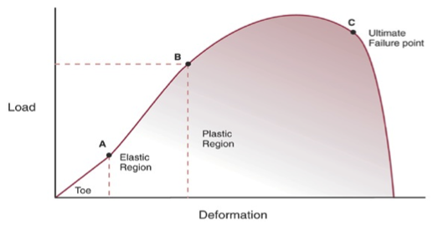
Load-deformation curve

Slide 10
Point A and point B is elastic region
Deformation will not permanent, structure will return to its original dimensions immediately after the load is removed
After point B, the yield point at the end of the elastic region,the material will no longer immediately return to its original state when the load is removed

Slide 11
Curve between point B and point C is plastic region
If loading continues through the plastic region, the material will continue to deform until it reaches the ultimate failure point, C point

Slide 12
Force values on the load-deformation curve depend on both the size of the structure and its composition
More cross sectional area – more force- with less deformation than a structure of the same original length with less cross sectional area.

Slide 13
A longer structure deforms more when a force is applied than does a shorter structure of similar cross section.

Slide 14
Stress and Strain
When loads are applied to a structure or material, forces with in the material are produced to oppse the applied force
These forces with in the material depend on the composition the material.

Slide 15
When the applied force is tensile, we calculate the stress on the tissue
Stress, force per cross-sectional unit of material, can be expressed mathematically with the formula, where S=stress, F=force, A=area
S=F/A
Stress measuring unit is pascals or megapascals

Slide 16
Same unit used to measure pressure, which is also force per unit area
Pressure produce compressive forces applied perpendicular to the surface of material

Slide 17
The percentage change in the length or cross section of a structure or material is called strain
It cannot measure directly but calculated mathematically strain= (L2-L1 )/L1
L1-Original length
L2-final length

Slide 18
If two applied forces act along the same line but in opposite direction, they create a distractive or tensile load and causes tensile stress and tensile strain in the structure or material.

Slide 19
If two applied forces act in a line toward each other they constitute compressive loading and compressive stress and as a result compressive strain will develop in the structure

Slide 20
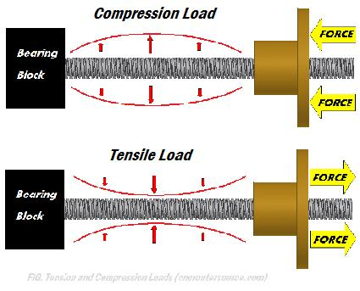

Slide 21
Young’s Modulus
Or modulus of elasticity
It is a measure of the materials stiffness(its resistance to external loads)
A value for stiffness can be found by dividing the change in stress by the change in strain for any two consecutive sets of points in the elastic range of the curve

Slide 22
Inverse of stiffness is compliance
If the slop of the curve is steep and the modulus of elasticity is high, the material exhibits high stiffness and low compliance
If the slop of the curve is gradual and the modulus of elasticity is low, the material exhibits low stiffness and a high compliance

Slide 23
Load deformation and stress-strain curves
Each material has its own unique stress-strain curve
Toe region- (0-A) very little force require to deform tissue
Minimum force –large amount of tissue deformation
Eg test for ligament integrity for non injured ligaments

Slide 24
Second portion(A-B) elastic region
Elongation (strain) has a linear relationship with stress
Third region (B-C) plastic region
Failure of collagen fibers(microfailure) begins
Lig or tendon not able to reach the original state
Clinical eg grade I and II ligament sprain

Slide 25
If force continues lead t macrofailure of the tissue
Lead to connective tissue fiber rupture
Failure occurs at the bony attachments of the ligament or tendon it is called avulsion
Failure to bony tissue called fracture

Slide 26
viscoelasticity
All connective tissues are viscoelastic material
Combine the properties of elasticity and viscosity
Elasticity implies that length changes or deformations are directly proportional to the applied forces or loads
Eccentric muscle contraction – stretch the tendon and this elastic energy is returned during the subsequent shortening (concentric) contraction of the muscle-tendon unit.

Slide 27
Viscosity refers to material’s resistance to flow
It is a fluid property, and depends on the PG and water composition of the tissue.
A tissue with high viscosity will exhibit high resistance to deformation, whereas a less viscous fluid will deform more readily.

Slide 28
Time-Dependent and rate dependent properties
Viscous qualities make the deformation and return time-dependent
A viscoelastic material posesses characteristics of creep, stress-relaxation, strain-rate sensitivity and hysteresis

Slide 29
Creep
If a force is applied to a tissue and maintained at the same level while the deformation produced by this force is measured, the deformation will gradually increases
Force remain constant while length changes
Connective tissue gradually elongate (creep) after initial elastic response to a constant tensile load and then gradually return to their original length

Slide 30
Stress relaxation
If a tissue is stretched to a fixed length while the force required to maintain this length is measured, the force needed will decrease over time.
Length remains constant while force decreases

Slide 31
Hysteresis
When the force and length of the tissues are measured as force is applied and removed
The resulting load-deformation curves do not follow the same path
Not all energy is gained as a result of lengthening work is recovered during exchange from energy to shortening work, some energy lost as a heat

Slide 32
Strain- rate sensitivity
Most tissues behave differently if loaded rapidly or slowly,
When load is applied rapidly , the tissue is stiffer, an a larger peak force can be applied to the tissue than if the load was applied slowly so subsequent relaxation is larger if load applied slowly

Slide 33
Properties of specific tissues
Bone
Cortical bone is stiffer than cancellous (trabecular) bone –so cortical bone withstand greater stress
Cortical bone can withstand much higher compressive stresses before failing than tensile stresses.

Slide 34
The compressive strength of trabecular bone is also greater than tensile strength
Bone can withstand greater stress, and will undergo less strain, in compression than in tension

Slide 35
Large load applied over short period of time will produce high stresses and low strain(strain-rate)
Whereas loads applied over longer periods of time will produce lower stresses and higher strain(creep and stress relaxation).

Slide 36
The physiologic response of trabecular bone to increased loading is hypertrohy.

Slide 37
Tendons
Tendons exhibit creep when subjected to tensile loading, most often when stress is created via muscle contraction.
under normal conditions, tendons with greater cross-sectional areas should be able to withstand larger forces than tendons with smaller cross sectional areas , unless they are composed of weaker material

Slide 38
Thus, the achilles tendon can probably be assumed to be stronger than palmaris longus tendon
Tendons adapt readily to changes in magnitude and direction of loading.
Tendons subject to continual compressive forces will alter their composition to resemble cartilage, and their tensile strength may be decline.

Slide 39
Conversely tendon subjected to tensile loads especially physiological loads over long period of time will increase in size, collagen concentration, and collagen cross linking
Progressive loading successfully used to treat tendon dysfunction

Slide 40
ligaments
Tendons are difficult to test mechanically, so most of our knowledge of connective tissue response to tensile loading comes from ligament testing
Ligament must withstand forces in all direction

Slide 41
The physiological response of ligaments to intermittent tension is an increase in thickness and strength
Immobilised lig

Slide 42
Cartilage
3 forces interact in cartilage to resist applied load
Stress developed in the fibrillar portion of extracellular matrix(collagen type II)
Swelling pressure developed in the fluid phase(PG and water)
Frictional drag resulting from fluid flow through the extracellular matrix

Slide 43
Tensile stresses is called hoop stresses are created in the superficial collagen network as the compressed PGs and water push against the collagen fibers
The tensile behavior is similar to that of ligament and tendon

Slide 44
Cartilage from different zones show different tensile behavior

